Slide 1
Aviation Delay Analysis in Europe
By: John Rey Quidet

Slide 2
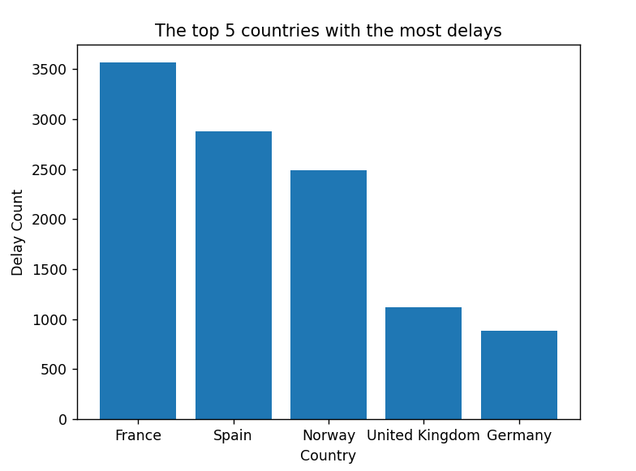
As you can see largest number of flight Delay belongs to France in 2026 (Jan 1 - Feb 28, 2026)

Slide 3
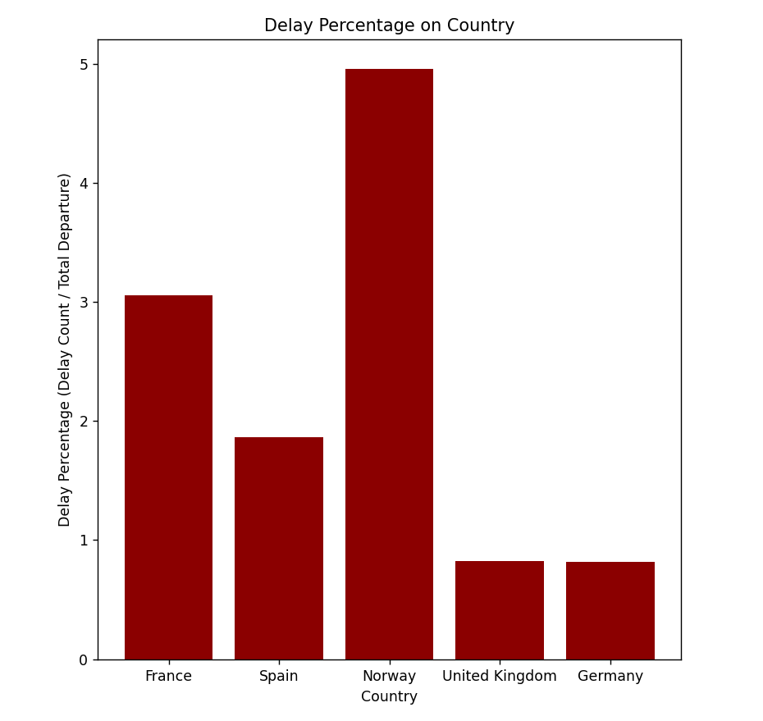
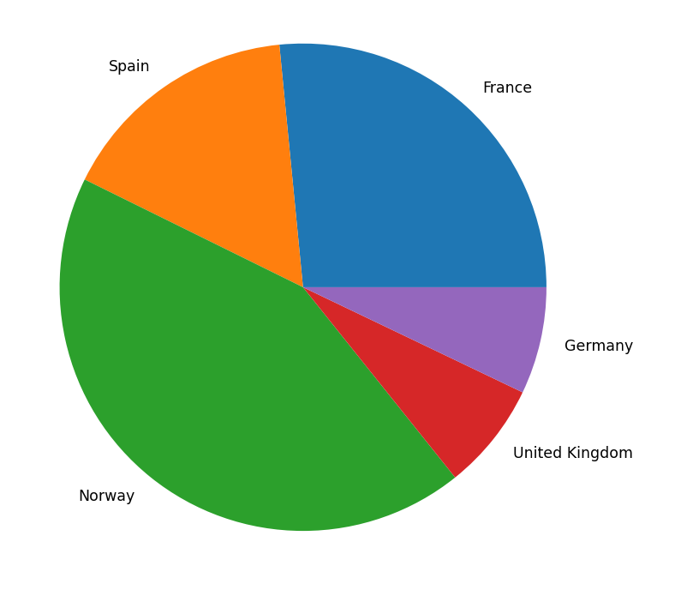
You can actually see that you are likely to have a Delay on the country of Norway than in France

Slide 4
Reference:
https://ansperformance.eu/csv/ (data used)

